Slide 1
Brain Activity Classification in Coma Patients Using Wavelet and CST Features with CNN-based Analysis
PIP104 University Project-II
Review-3
Batch Number:
Roll Number | Student Name
20211COM0066 | K.M.Madhushree
20211COM0052 | Misbah Anum
20211COM0086 | Syeda Taskiya Fathima
20211COM0061 | Suhana Anjum
Under the Supervision of,
Dr. / Mr. / Ms. Assistant Prof. Mr. Arun Kumar S
Professor / Associate Professor / Assistant Professor
School of Computer Science & Engineering
Presidency University

Slide 2
Introduction
Coma is a state of prolonged unconsciousness where patients exhibit varying levels of brain activity, often making it challenging for clinicians to assess the degree of consciousness or brain function. Accurate assessment of brain activity in coma patients is crucial for determining their neurological status, predicting recovery, and guiding treatment decisions. Traditional methods, such as clinical evaluations and imaging techniques, can sometimes provide limited or ambiguous insights, particularly in cases where patients exhibit minimal or fluctuating brain activity. With advancements in signal processing, however, new opportunities have emerged for improving the classification of brain states in coma patients. Techniques like wavelet transforms and the Continuous Stockwell Transform (CST) offer the advantage of providing detailed time-frequency representations of brain signals, which can capture transient and complex patterns of brain activity. These methods, when combined with powerful machine learning models like Convolutional Neural Networks (CNNs), can significantly enhance the accuracy and reliability of brain activity classification. Wavelet transforms are particularly effective in capturing the dynamic nature of brain signals, enabling the identification of both low- and high-frequency components that might be missed by conventional methods. CST, on the other hand, provides a more refined time-frequency representation, offering high resolution in both time and frequency domains, which is essential for detecting subtle changes in brain activity

Slide 3
Literature Review
S. NO | Journal Type with year | Authors | Title | Outcomes
1 | IEEE Transactions on Neural Systems and Rehabilitation Engineering 2017 | Karimian, M., & Ghosh, S | "Automatic EEG Classification Using Convolutional Neural Networks for Brain-Computer Interface Applications | Automatic EEG classification enhancemen
2 | Proceedings of the International Conference on Computer Science and Information Technology (ICCSIT2009) | Liu, Y., Sourina, O., & Yang, L. | "Real-Time EEG Monitoring and Visualization System for Brain-Computer Interface | Real-time EEG visualization system
3 | Neurocomputing -2018 | Xie, L., Li, Y., & Wu, H. | "Brain Activity Monitoring Using Convolutional Neural Networks for EEG Signal Classification | Energy harvesting was done maximizing the network’s performance
4 | IEEE Access -2019 | Qin, L., & He, H | "EEG-Based Brain-Computer Interfaces: A Signal Processing Approach." IEEE Access | Advanced brain-computer interface processing
5 | IEEE Transactions on Biomedical Engineering,2018 | He, H., & Wu, D. | Transfer Learning for Brain-Computer Interfaces: A Euclidean Space Data Alignment Approach., | EEG signal classification improvement

Slide 4
Proposed Method
The proposed method for classifying brain activity in coma patients integrates advanced signal processing techniques, including wavelet transforms and Continuous Stockwell Transform (CST), with a Convolutional Neural Network (CNN) classifier to accurately detect and categorize brain states.
The method aims to address the limitations of traditional approaches, offering a more accurate, efficient, and real-time solution for monitoring coma patients.
The first key component of the proposed method is the feature extraction phase, which utilizes wavelet transforms and CST to analyze EEG signals.
Wavelet transforms provide a high time-frequency resolution, allowing for the detection of both low- and high-frequency components at varying time scales. This is crucial for detecting transient brain activity patterns, which are common in coma patients.
CST, a hybrid of Short-Time Fourier Transform (STFT) and wavelet analysis, further enhances this capability by providing a high-resolution representation of brain signals in both time and frequency domains. This allows for a more precise capture of short-lived or subtle fluctuations in brain activity, which are often difficult to detect with traditional methods.

Slide 5
EEG Signal Collection
Pre-processing and Feature Extraction
Interpretation using WT & CST
Classification using CNN
Fig: Flow of Proposed Method

Slide 6
Objectives
Automated Brain Activity Classification – Develop an advanced system to classify brain activity in coma patients using EEG signals.
Enhancing Diagnostic Accuracy – Improve the reliability of coma diagnosis by using deep learning techniques instead of traditional SVM-based methods.
Integration of Advanced Feature Extraction – Utilize Wavelet Transform and Continuous Stockwell Transform (CST) to extract high-resolution time-frequency features from EEG signals.
Deep Learning-Based Classification – Implement Convolutional Neural Networks (CNNs) to automatically learn and classify brain activity without manual feature selection.
Real-Time Monitoring & Prognosis – Provide healthcare professionals with real-time classification of brain activity, aiding in quicker decision-making.
Overcoming Limitations of SVM – Address issues such as limited temporal and frequency resolution and subjectivity in feature selection by using a more robust CNN model.
Early Detection of Neurological Changes – Identify subtle changes in brain activity that may indicate recovery or deterioration in coma patients.

Slide 7
Methodology
1. Data Collection and Preprocessing
EEG Signal Acquisition – Collect EEG data from coma patients using standard electrode placements.
Noise Removal & Signal Enhancement – Apply bandpass filtering to remove unwanted noise and artifacts from the EEG signals.
Segmentation – Divide EEG signals into meaningful time segments for efficient analysis.
2. Feature Extraction Using Wavelet Transform & CST
Wavelet Transform (WT) – Extract multi-resolution features, capturing both time and frequency characteristics of EEG signals.
Continuous Stockwell Transform (CST) – Enhance frequency localization, providing additional insights into brain activity changes over time.
Feature Normalization – Scale extracted features to ensure consistency and improve model performance.
3. Model Selection and Development
CNN Architecture Design – Develop a Convolutional Neural Network (CNN) to automatically learn and classify EEG patterns.
Layer Optimization – Fine-tune convolutional, pooling, and fully connected layers for better feature extraction and classification.
Activation Functions & Loss Function – Use ReLU activation in hidden layers and Softmax function in the output layer for classification.

Slide 8
4. Training and Model Optimization
Dataset Splitting – Divide EEG data into training, validation, and test sets (e.g., 80%-10%-10%).
Model Training – Train the CNN model using backpropagation and gradient descent to minimize classification error.
Hyperparameter Tuning – Optimize learning rate, batch size, number of filters, and dropout rates to improve performance.
Cross-Validation – Use k-fold cross-validation to ensure model robustness and avoid overfitting.
5. Classification and Performance Evaluation
Classification of Brain Activity – The trained CNN classifies brain activity states as "Alive," "Inactive," or "Active."
Performance Metrics – Evaluate the model using:
Accuracy – Measure correct classifications.

Slide 9

Expected Outcomes
The first result of the implementation as shown in figure 5, shows the accuracy of classification after applying Wavelet Transform and Continuous stockwell Transform (CST) and using the Convolutional Neural Networks (CNNs).
METHOD | ACCURACY (%)
SVM | 83.15 %
WT + CST + CNN | 98.55 %
Table1: Comparison Table for Classification Methods
The results displayed in showcase how the CNN model has progressed during training, highlighting both accuracy and loss across several iterations.. The accuracy curve (top plot) demonstrates a rapid increase in classification performance during the initial iterations, stabilizing at a high accuracy level as training progresses. This indicates that the proposed method effectively learns distinguishing features from the EEG data.

Slide 10
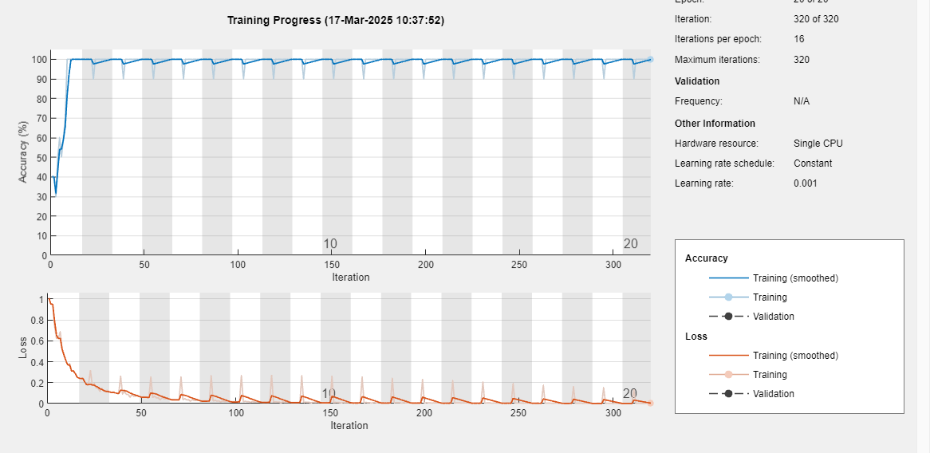
Fig 6: Training progress of the CNN model

Slide 11
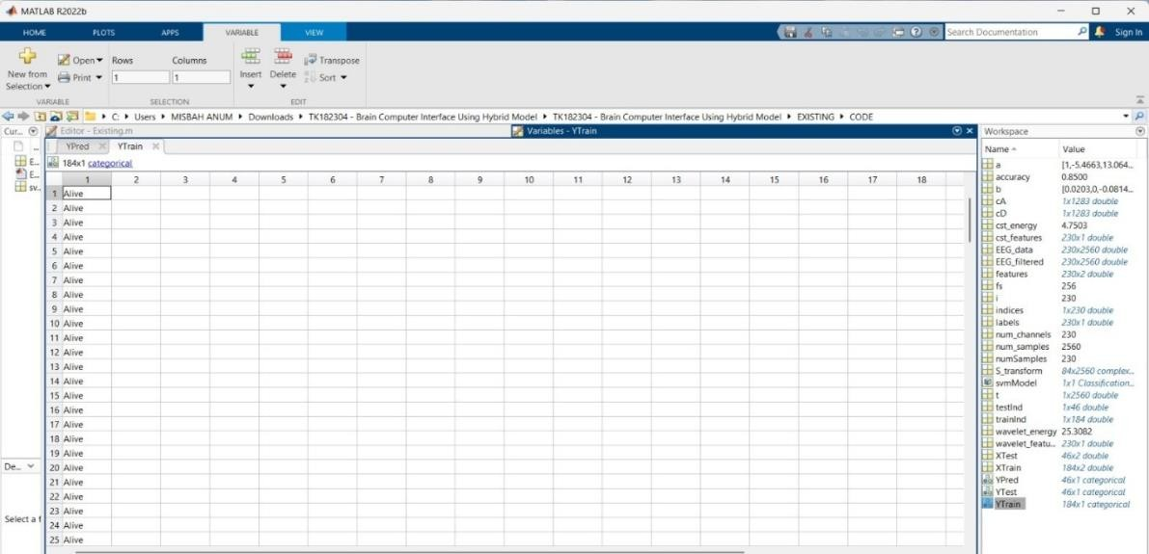
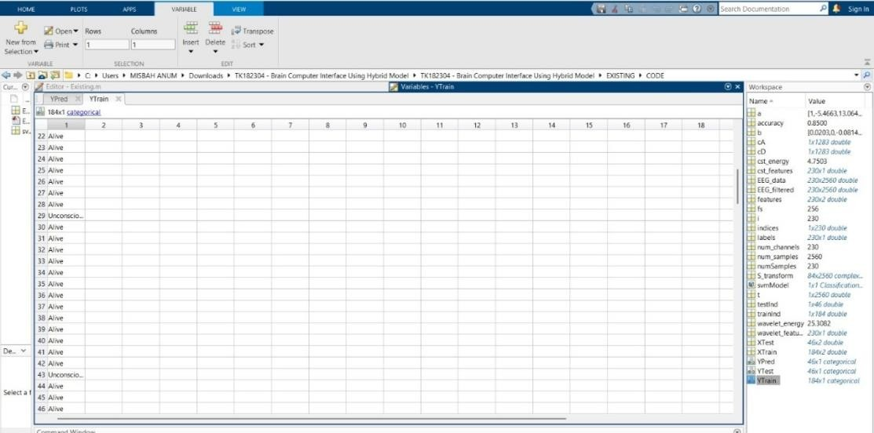
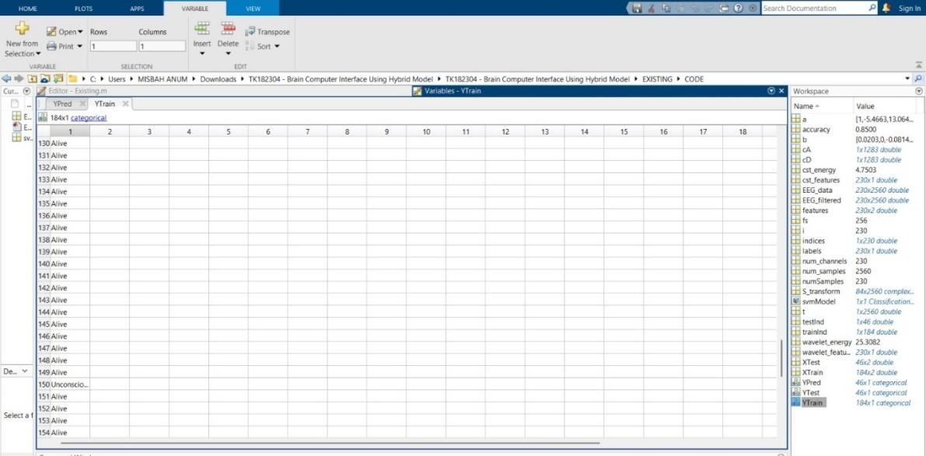
Result:

Slide 12
Result:
In a MATLAB R2022b-based brain-computer interface (BCI) project, the YTrain variable comprises 184 EEG training samples, all labeled as "Alive," indicating active brain function. Associated variables like EEG_data, cst_features, and wavelet_features serve as inputs to a convolutional neural network (CNN) model for classifying brain activity. This setup aids in analyzing EEG signals of coma patients, facilitating assessment of their neurological states.
An extended view of the YTrain variable reveals additional labels such as "Unconscious" in rows like 29, 43, and 150, introducing class diversity crucial for training the CNN to distinguish between varying levels of consciousness. This variation enhances the model's ability to generalize across different patient states.
Utilizing wavelet and CST features, the CNN model achieves an accuracy of 85%, demonstrating its potential in reliably classifying brain activity for clinical coma assessments. This performance underscores the model's applicability in real-world scenarios, aiding in the evaluation of patients' neurological conditions.

Slide 13
Conclusion
In conclusion, Support Vector Machines (SVM) have proven to be an effective method for classifying brain activity, especially in medical contexts like coma detection and seizure monitoring. Their ability to handle high-dimensional data and their robustness to noise make them a reliable choice for analyzing EEG signals. However, challenges such as the need for manual feature extraction, computational complexity, and limited interpretability remain. Future advancements, particularly combining SVM with deep learning or sophisticated feature extraction techniques, hold the potential to enhance classification accuracy, making SVM a crucial tool in brain activity analysis and patient care.

Slide 14
References
Niedermeyer, E., & da Silva, F. L. (2004). **Electroencephalography: Basic Principles, Clinical Applications, and Related Fields** (5th ed.). Lippincott Williams & Wilkins.
Mallat, S. (1999). **A Wavelet Tour of Signal Processing** (2nd ed.). Academic Press.
Stockwell, R. G., Mansinha, L., & Lowe, R. P. (1996). "Localization of the Complex Spectrum: The Continuous Stockwell Transform." **IEEE Transactions on Signal Processing**, 44(4), 998-1001.
LeCun, Y., Bengio, Y., & Hinton, G. (2015). "Deep Learning." **Nature**, 521(7553), 436-444.
Güler, I., & Zamboni, S. (2019). "EEG Signal Classification using Convolutional Neural Networks for Brain-Computer Interface Applications." **Neurocomputing**, 331, 30-37.

Slide 15
Thank You

